Slide 1
Unveiling the Intricacies of Predictive Modelling for House Prices Utilizing Advanced Regression Techniques
Enhancing Real Estate Valuation with Data-Driven Insights
EGBULE OMOZE MERCY
16-08-2024

Slide 2

Outline
Project Overview
Data Collection and Data Cleaning
Exploratory Data Analysis (EDA)
Feature Engineering and Feature Preprocessing
Building Predictive Models and Evaluation
Results and Insights
Conclusion and Recommendations

Slide 3
PROJECT OVERVIEW
PROBLEM STATEMENT
Given a dataset containing various residential property features, the challenge is to develop a predictive model that accurately estimates house sale prices, aiding buyers, sellers, and real estate professionals in making informed decisions.
OBJECTIVE
To build and evaluate a predictive model for house prices using advanced regression techniques, ensuring high accuracy and reliability in estimating property values based on key features.

Slide 4
DATA COLLECTION
Data Source: Kaggle competition dataset on house price
Data Description:
Training set: 81 columns, 1,460 rows.
Test set: 80 columns, 1,459 rows.
Features Highlight: MSSUbclass, MSZoning, Utilities Type, Lot Frontage, YearBuilt and Neighborhood
Data Cleaning:
Duplicates: There was no duplicates in the dataset
Missing Values: There are 19 columns with missing values,PoolQC being the column with the highest number of missing values.
Handling Missing Values: Filled categorical columns with "NIL" and numerical columns with 0, because the missing values might be due to unavailability of such column.
Outliers: Identified using boxplots and handled using the Interquartile Range (IQR) method and filled using the clip method

Slide 5
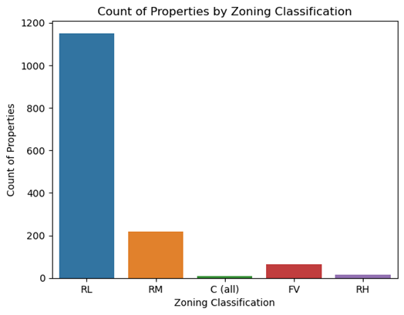
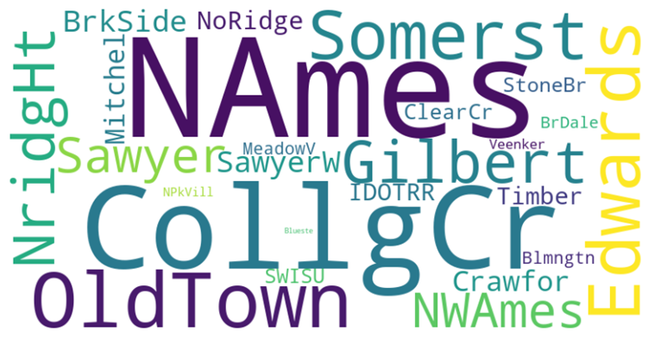
Exploratory Data Analysis
Univariate Analysis

Slide 6
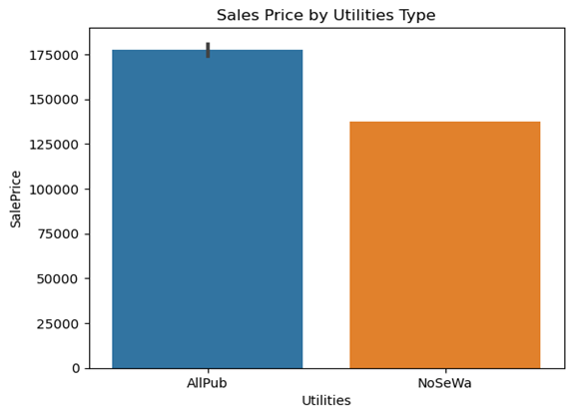
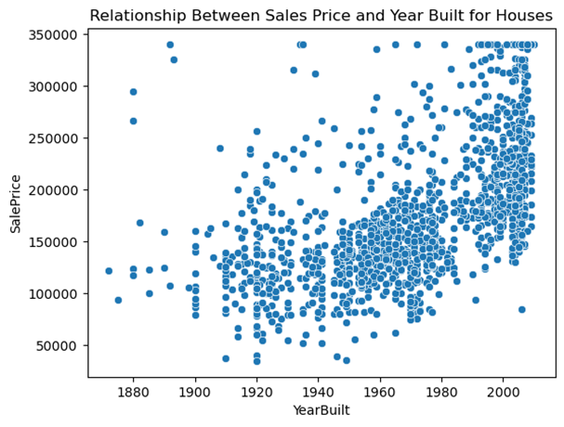
Exploratory Data Analysis
Bivariate Analysis with respect to the target feature

Slide 7
Feature Engineering & Feature Preprocessing
Feature Engineering: Created 5 new features (e.g., house age, remodel age, total square footage) from the existing features in our dataset.
Feature Preprocessing: One-hot encoder, LabelEncoder, StandardScaler
Feature Selection: Principal component Analysis(PCA) was used for feature selection by reducing features from 210 to 5 components.

Slide 8
Model Training and Evaluation
Models Used: Linear Regression, Decision Tree, Random Forest, Gradient Boosting, SVR.The model was built with the default parameters in order to ascertain the base model. Random Forest outperforms other models which was used as the base mode
Hyperparameter Tuning: Tuning was carried out on each model using Random search because of its less process time. The tuning was on 3 parameters of each model. The model performed better after tuning
Evaluation Metrics: RMSE, MAE,R².
Best Model: Random Forest.
Best Model Performance after Tuning:The best performing model was based on lower RMSE, MAE and higher R2 score. RMSE: 23,426.85, MAE: 16,883.95, R²: 0.887

Slide 9
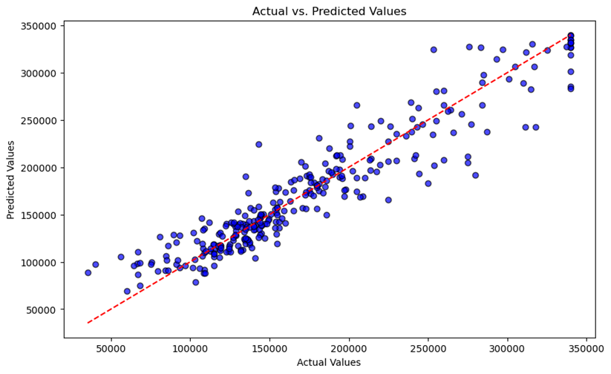
Results and Insights
Random Forest model provides accurate predictions and explains 89% of the variance in house prices.The type of Neighborhood, Year built, utilities type has an influences the price of a house.
Actual vs. Predicted Plot: Shows how well the predicted values match the actual values. The red dashed line represents a perfect prediction.

Slide 10

CONCLUSION

